Slide 1
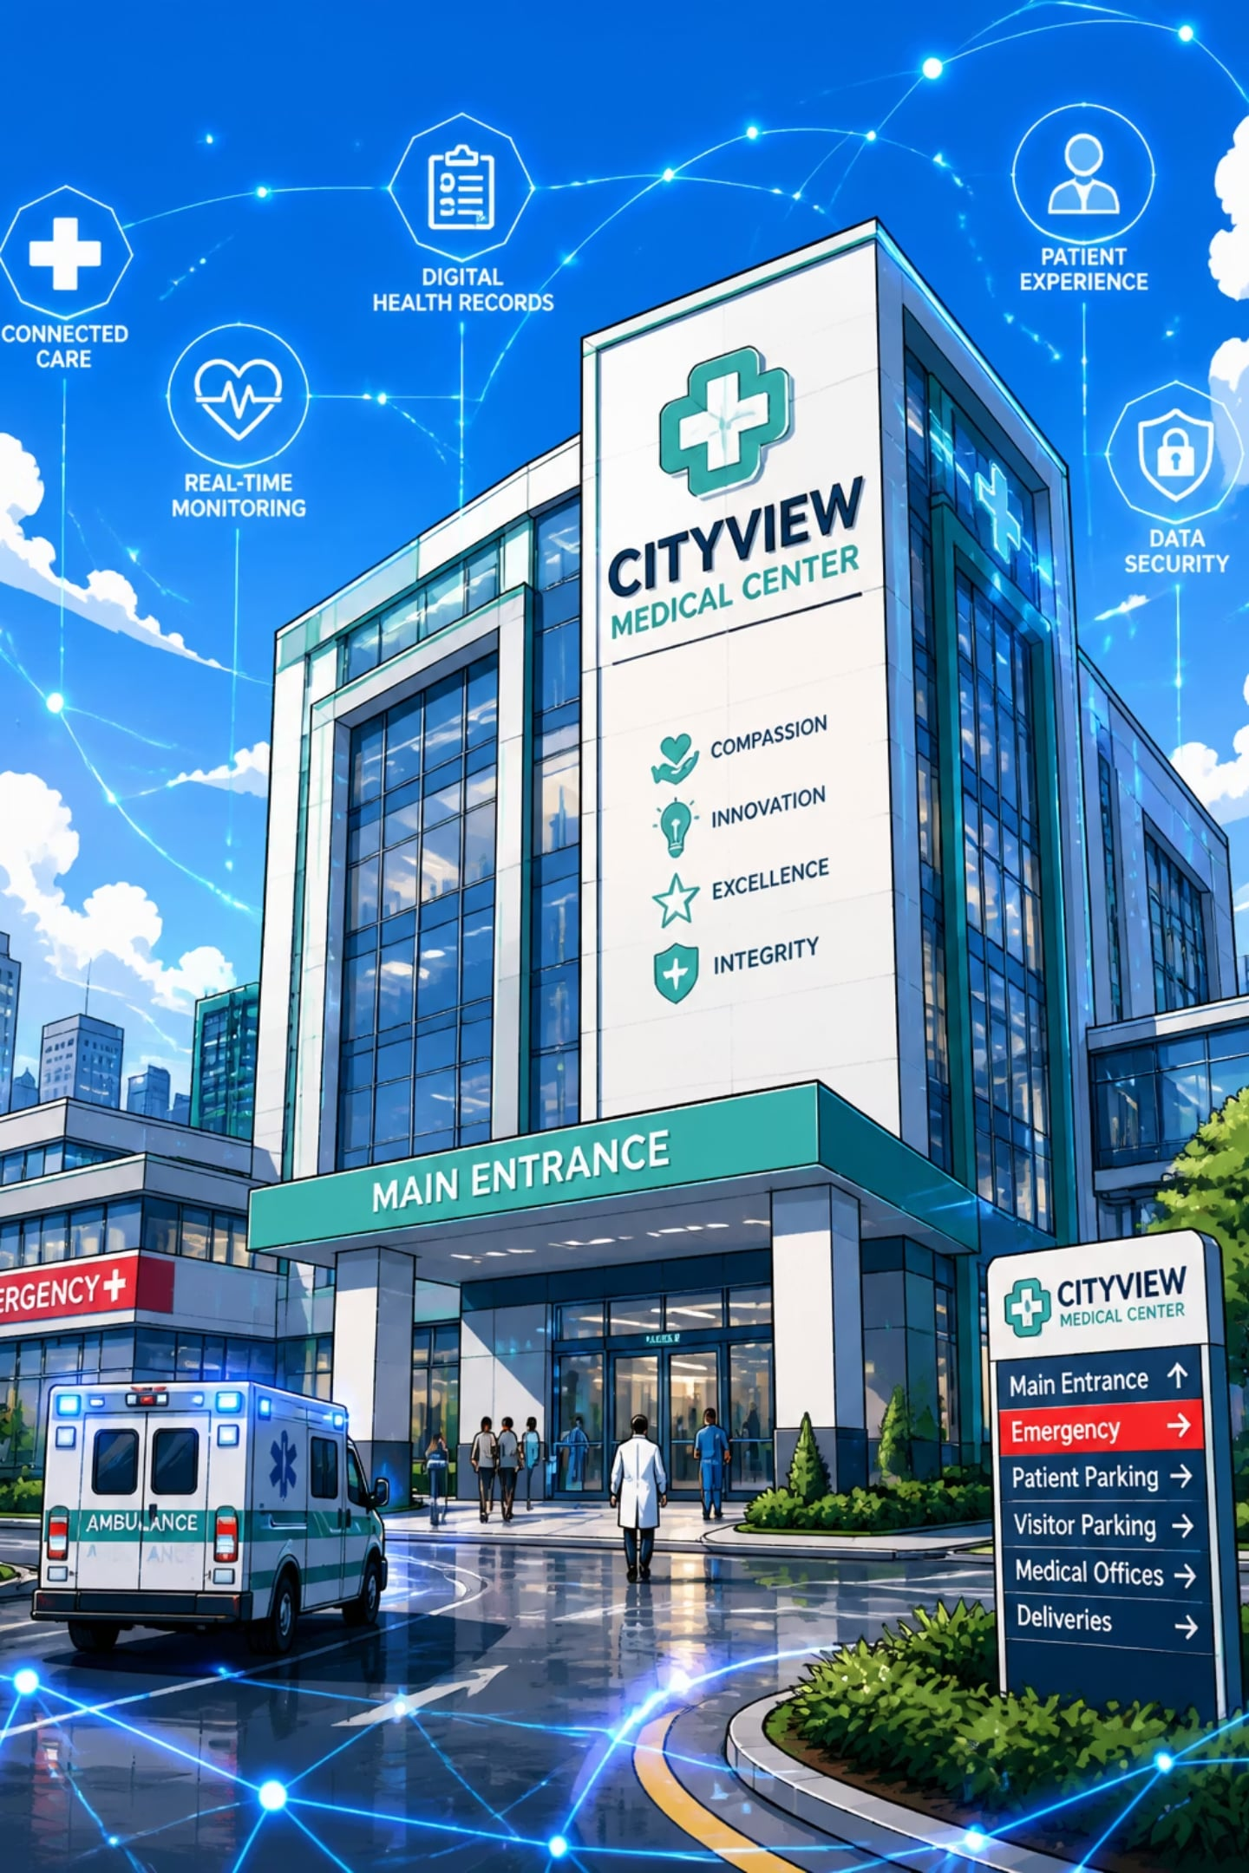
Object-Oriented Design in Smart Healthcare System
Name : Delisha A.K.
Registration No: 192511307
Course Name : Object-Oriented Analysis and Design (CSA1110)

Slide 2
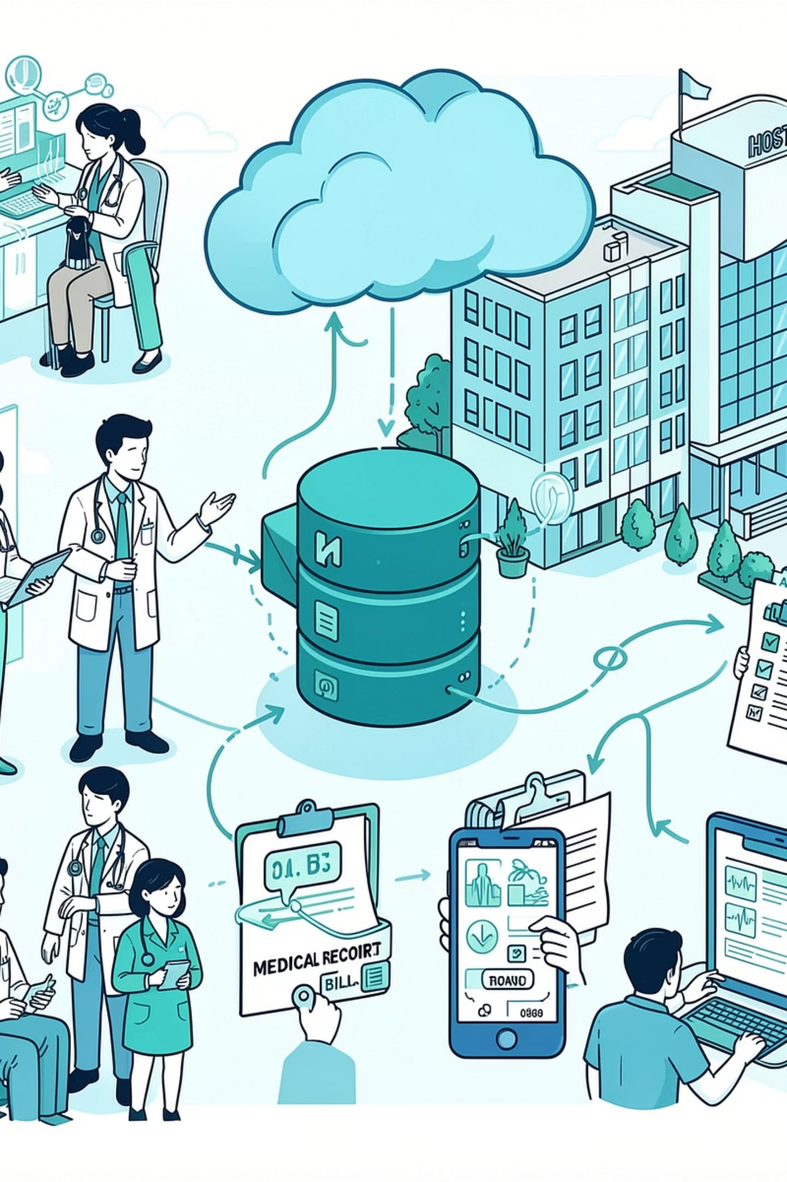

Smart Healthcare Ecosystem
Book Appointment
Doctor Consults
Update Records
Generate Billing
- Integrated flow: scheduling → consultation → record update → billing → analytics.
- Real-time data sync across modules.
- Event-driven notifications for clinicians and patients.
- Clear audit trail for compliance and quality.

Slide 3
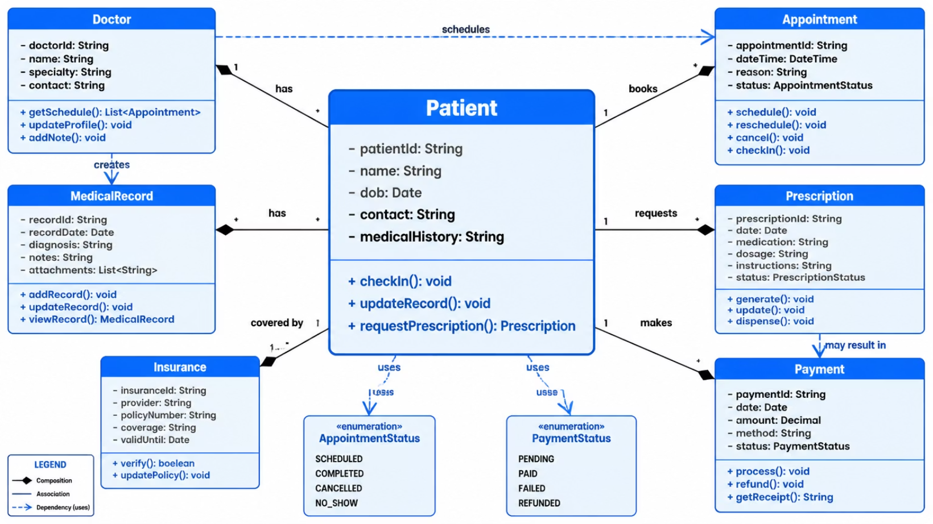
Classes & Objects — Patient Example
Patient (class)
Attributes: patientId, name, dateOfBirth, contactInfo, medicalHistory
Methods: checkIn(), updateRecord(), requestPrescription()
Instance = a specific patient object with real data
Encapsulates state + behavior for patient entity

Slide 4
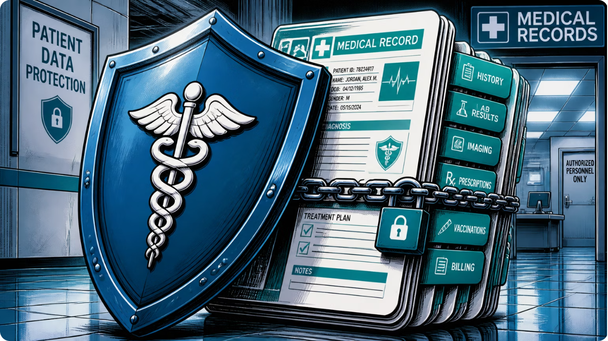
Encapsulation — Protecting Patient Data
- Use private attributes for sensitive fields (e.g., medicalHistory, ssn).
- Expose controlled access via getters/setters with validation.
- Reduce unintended mutations and enforce invariants.
- Enables secure serialization and audit logging.

Slide 5

Inheritance — Shared Person Model
Nurse
shift; assistTreatment()
Doctor
specialization; prescribeMedicine()
HospitalStaff
staffID, name, department
Both Doctor and Nurse inherit common attributes from HospitalStaff while adding specialized properties and methods.

Slide 6


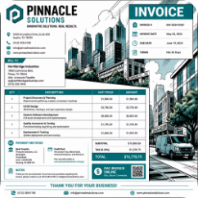
Polymorphism — generateReport()
Patient Report
Doctor Report
Billing Report
Summary of vitals, meds, next steps — designed for patient comprehension.
Detailed clinical notes, diagnostics, decision support data.
Charges, insurance claims, coding metadata for finance systems.
- Single interface: generateReport(Person) → runtime selects concrete implementation.
- Enables extendable reporting without service changes.

Slide 7





Benefits of Object-Oriented Design
Scalability
Maintainability
Security
Modular components scale independently across services.
Clear abstractions reduce coupling and ease updates.
Encapsulation and controlled access limit attack surface.
Reusability
Reliability & Modularity
Shared base classes and interfaces reduce duplication.
Unit-testable modules and clear contracts improve robustness.

Slide 8

Conclusion — OOAD for Smart Healthcare
- Object-oriented design provides a clear, modular foundation for secure, scalable healthcare systems.
- Encapsulation protects patient data; inheritance & polymorphism enable flexible extensions.
- Apply proven patterns and strong interfaces to ensure maintainability and testability.
- Result: resilient systems that support clinical workflows and regulatory needs.

